Slide 1
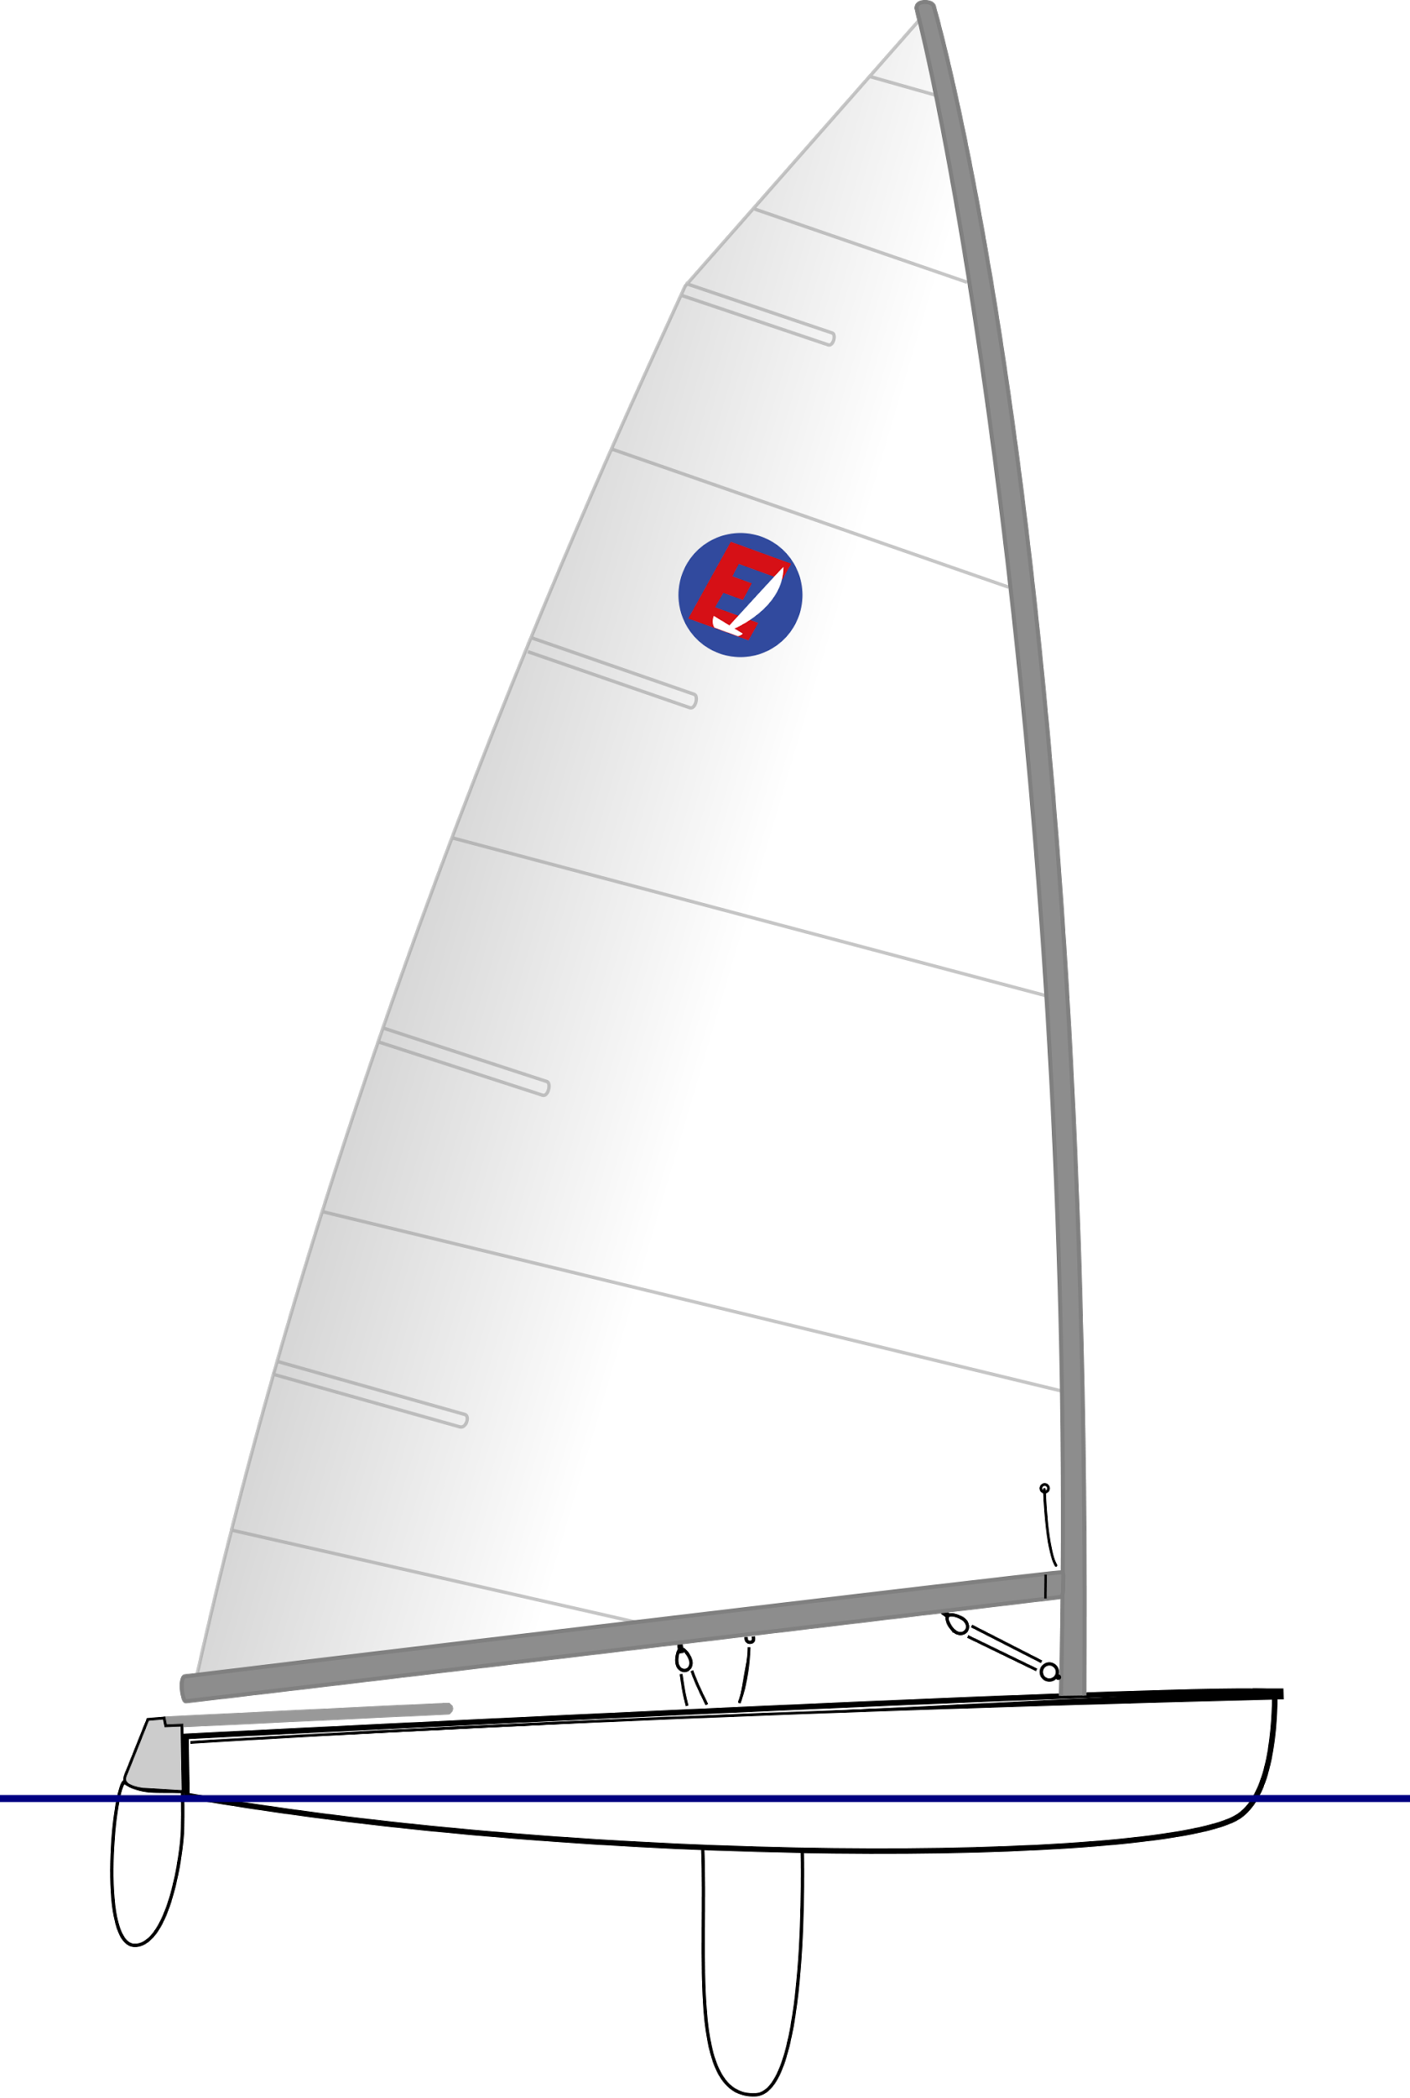
Dinghy Project
Mattias Kallsäby
Niklas Lundborg
David Ragnarsson
Fredrik Ödmark
Jesper Wälivaara
Alexander Örneskans
Björn Paulström

Slide 2
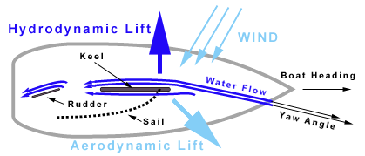
Background Dinghy Project
Sensors in the world of boats
Wind, temperature, depth, speed in water, speed over ground

Slide 3
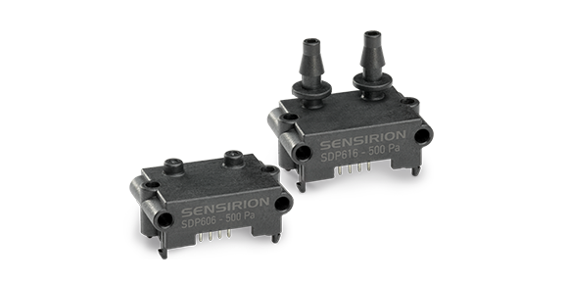
Primary Goals
Differential pressure sensor
Hydrodynamic lift
Bearing/Direction
Logging

Slide 4
Secondary Goals
Speed over ground
Angular Velocity
Positioning

Slide 5
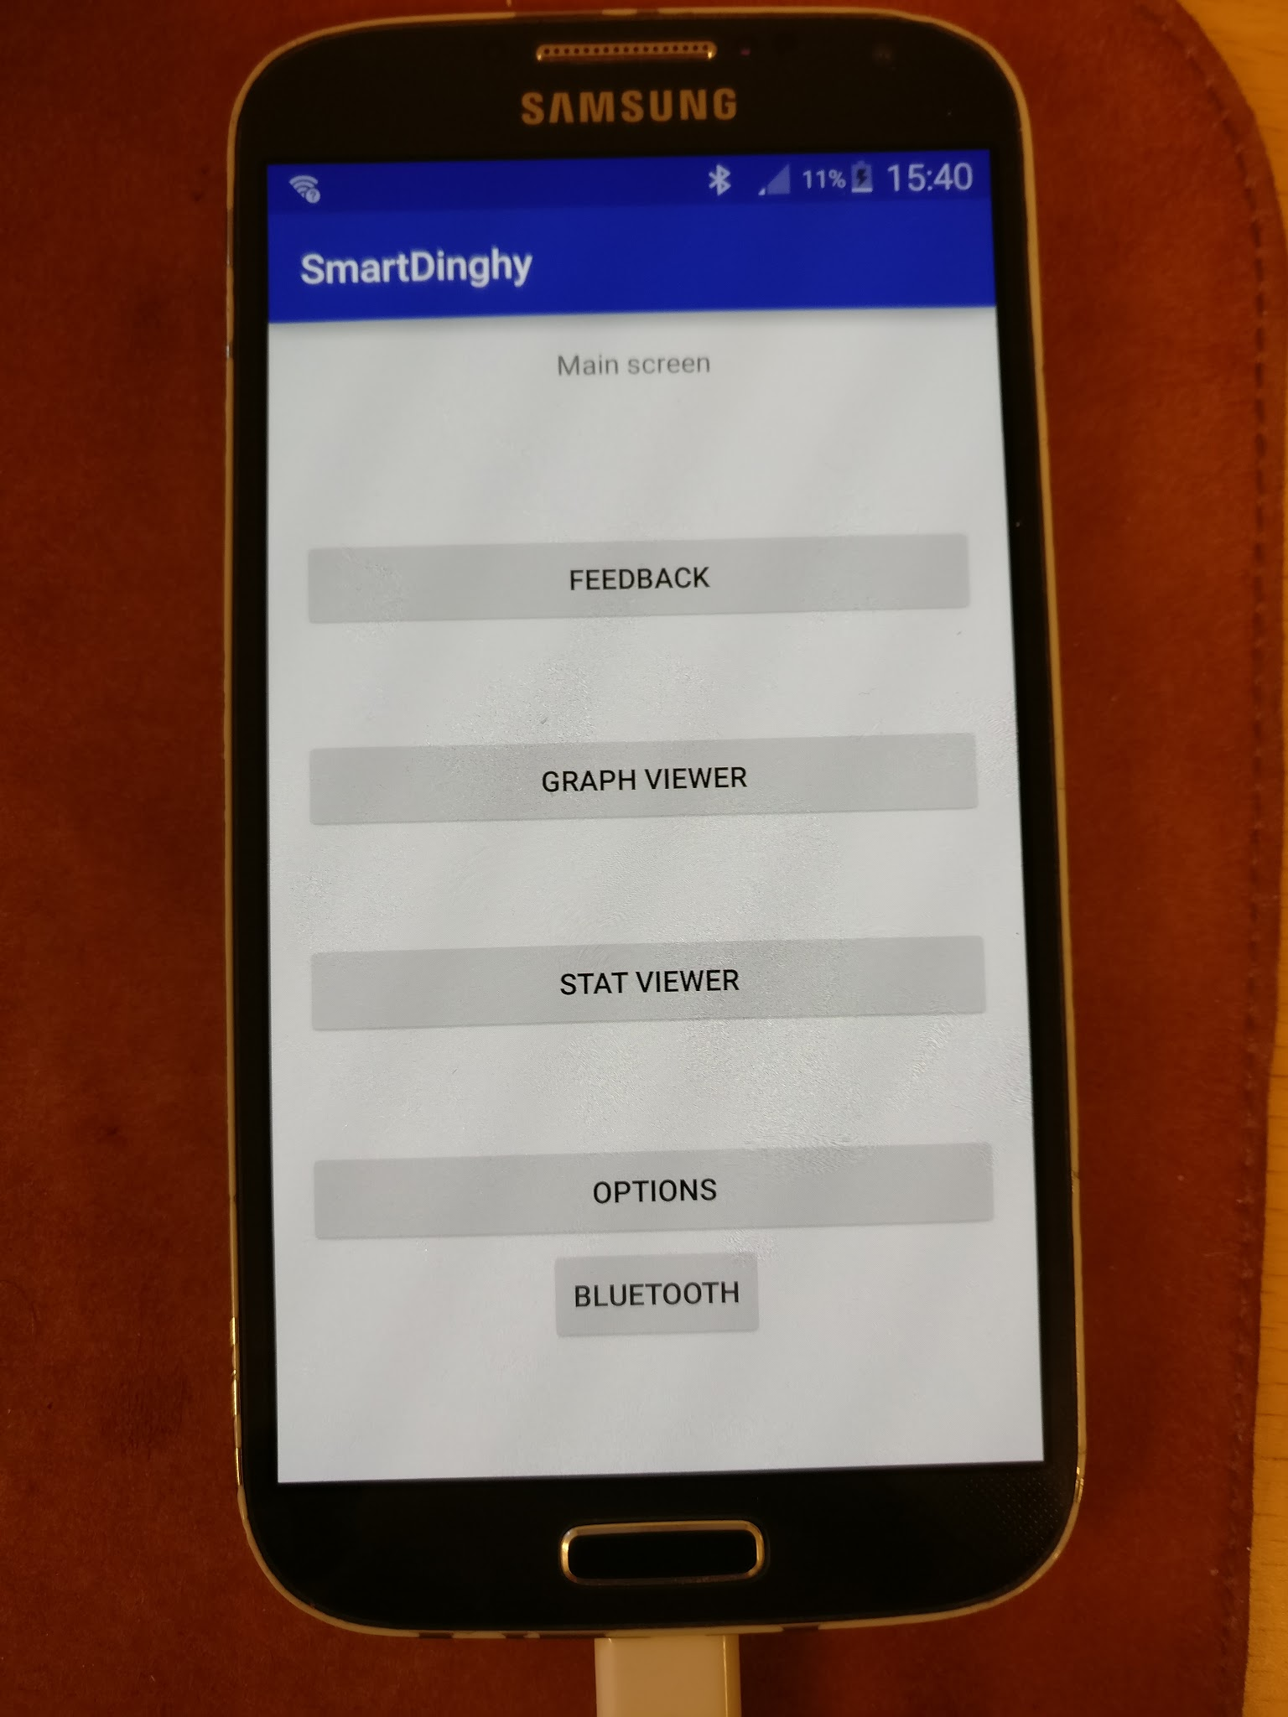
Additional Goals
Feedback to skipper (Human interface)
Speed in water
Inclination
Windsensor (NMEA)

Slide 6
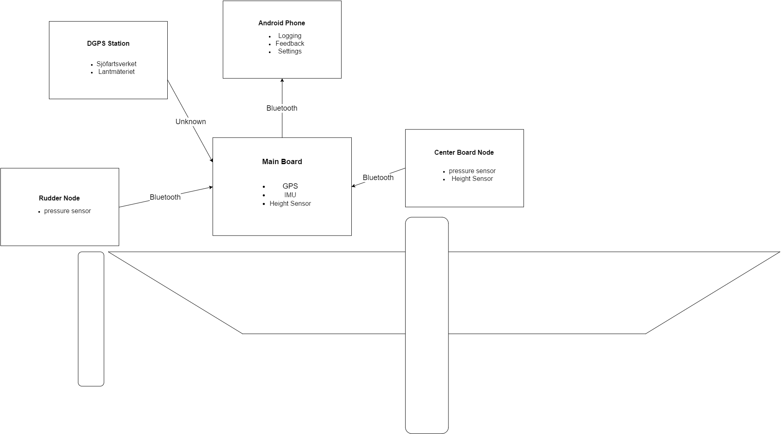
System Overview

Slide 7
